Slide 1



CROPS
ANIMALS
FISH
HARVEST
FRUIT
MINERALS
ARTIFACTS

Slide 2




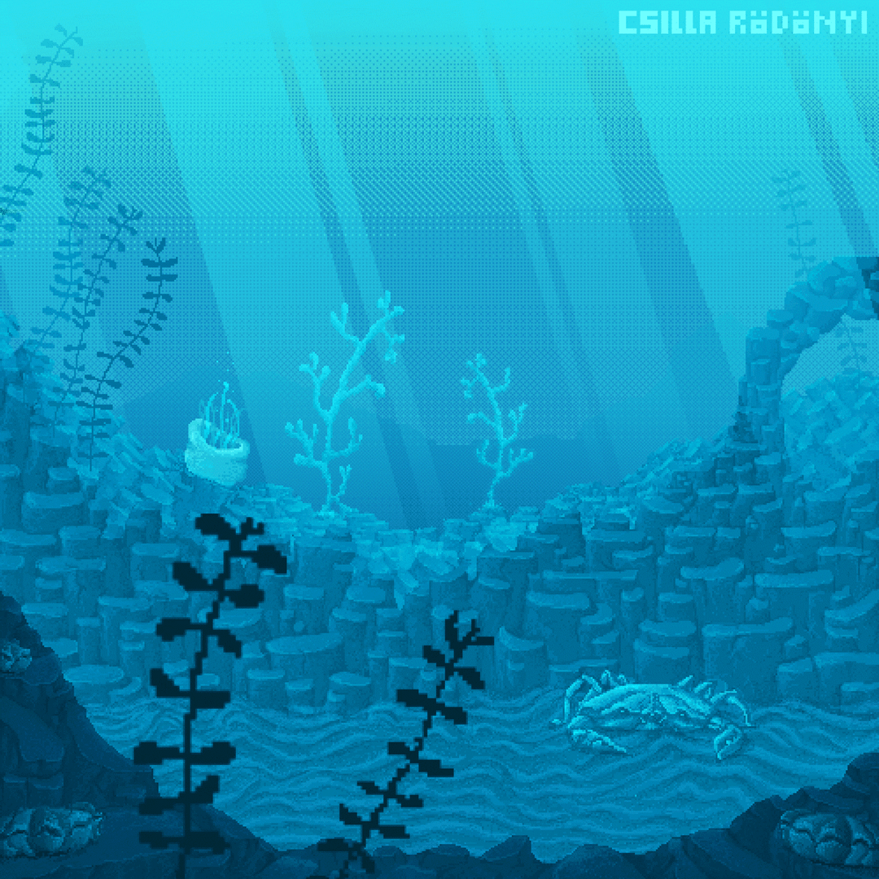


LEGENDARY FISH
COST
PRODUCT 1
PRODUCT 2
SELL PRICE
SELL PRICE
SELL PRICE
SELL PRICE
DAYS TO PRODUCE
SELL PRICE
SELL PRICE
DAYS TO RECOVER
DAYS TO RECOVER

Slide 3
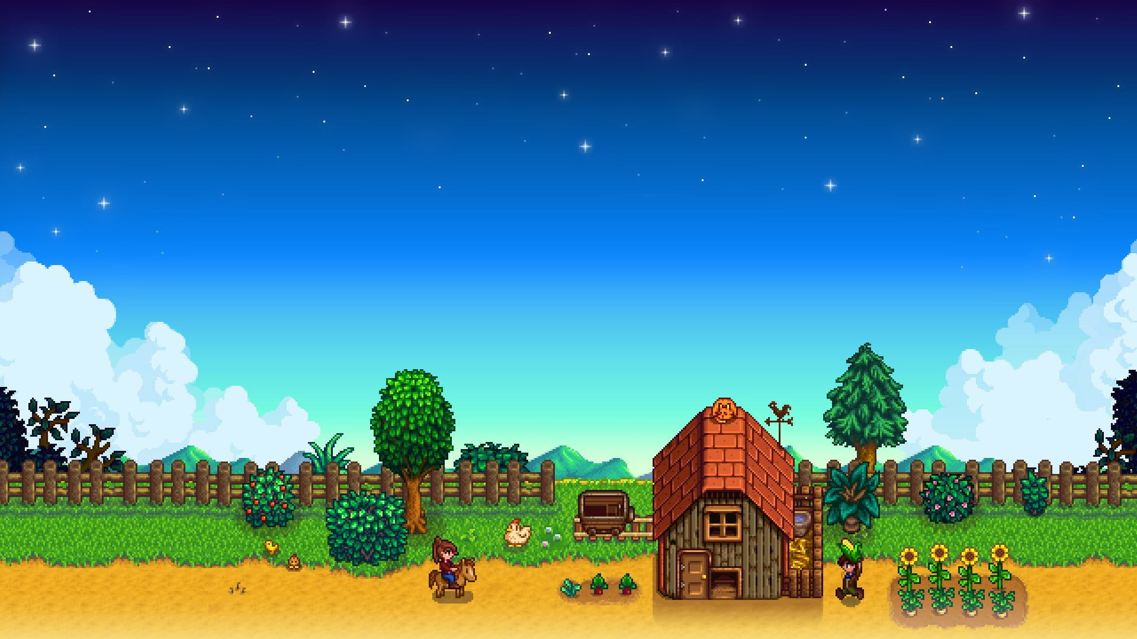





SELL PRICE
SELL PRICE
SELL PRICE
SELL PRICE
COST
MIN DAYS TO RECOVER
MAX DAYS TO RECOVER
TOP 10 BEST HARVESTS ITEMS
GROWTH TIME
REGROWTH TIME

Slide 4




BEST
WORST
BEST
WORST
MINERAL NAME
MINERAL NAME
ARTIFACT NAME
ARTIFACT NAME
TOP 5 BEST ARTIFACTS
SELL PRICE
SELL PRICE
SELL PRICE
SELL PRICE
TOP 5 BEST ARTIFACTS

Slide 5


STRAWBERRY

Slide 6

BEST CROP BY SEASON
SPECIAL CROPS
SPRING
SUMMER
FALL
WINTER
Best Season by net income
Top 5 best crops

